Slide 1
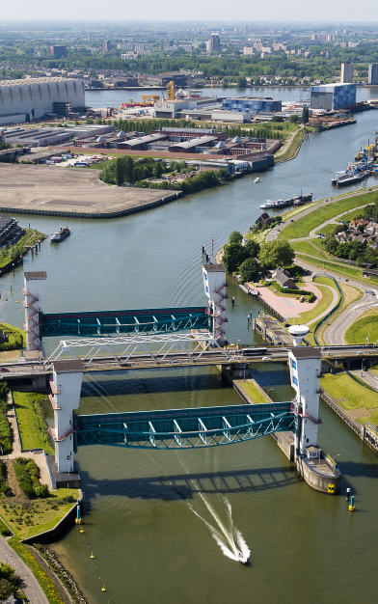
FLOOD RESILIENCE HOLLANDSE IJSSEL
!
Marco Weijland, Waterboard HHSK
Ina Konterman
Rijkswaterstaat
Notes:
Welcome, my name is Pim Neefjes and I will give you a brief introduction of The Deltaprogramma, with a short history, the challenges and choosen strategies.
Hollandsche IJsselkering. De Hollandsche IJsselkering beschermt het laagstgelegen deel van Nederland, 6,76 m onder NAP. Dit Deltawerk bij Krimpen aan den IJssel was als eerste van de 13 klaar. Rijkswaterstaat begon een jaar na de watersnoodramp (1953) met de bouw van de Hollandsche IJsselkering.

Slide 2
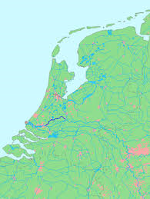
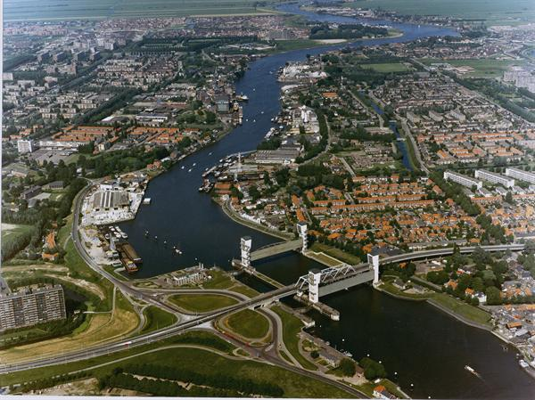
Hollandsche IJssel
Which (combinations of) measures for flood protection Hollandsche IJssel are cost effective?

Slide 3
Hollandse IJssel
Fresh water tidal river, connected to North Sea – high ecological value
Important source of fresh water for western part of the Netherlands
Shipping movements freight transport: 25.000/year
Area is partly densely populated, especially at western side of HIJ

Slide 4
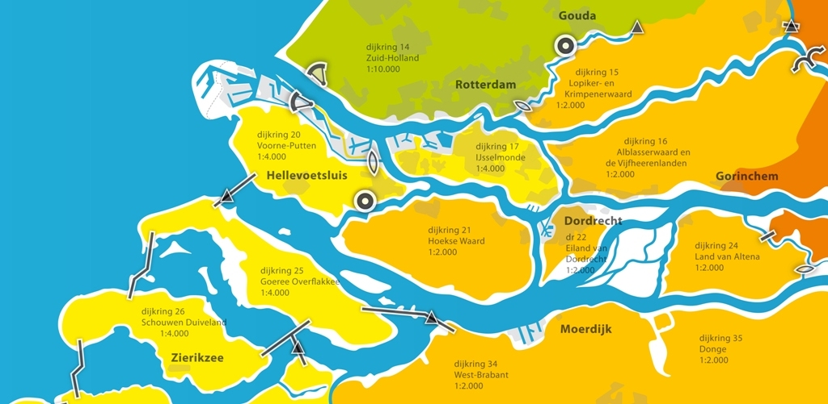
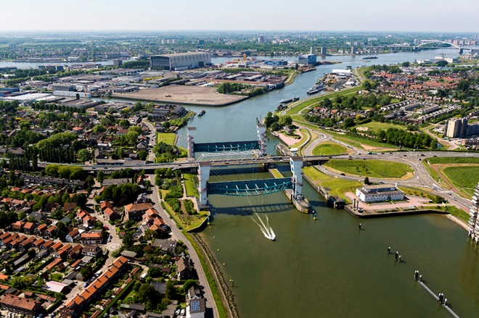
Asses further improvements of the HIJ barrier in relation to system of HIJ
Why?
Conclusion of system analysis of Deltaprogramme Rijnmond-Drechtsteden – look at system of HIJ as a whole
Large flood protection assignment expected at HIJ – what are alternatives for dike reinforcement?

Slide 5
Scope of our project
Scope
To find cost-effective sets of measures for the flood protection of the Hollandsche IJssel and incorporate these in the adaptation path of the Hollandsche IJssel
4 steps of our study
System analysis Hollandsche IJssel
Analyse sets of measures for flood protection
Study costs and external effects (ecology, shipping, etc.)
Formulate adaptation path for the Hollandsche IJssel

Slide 6
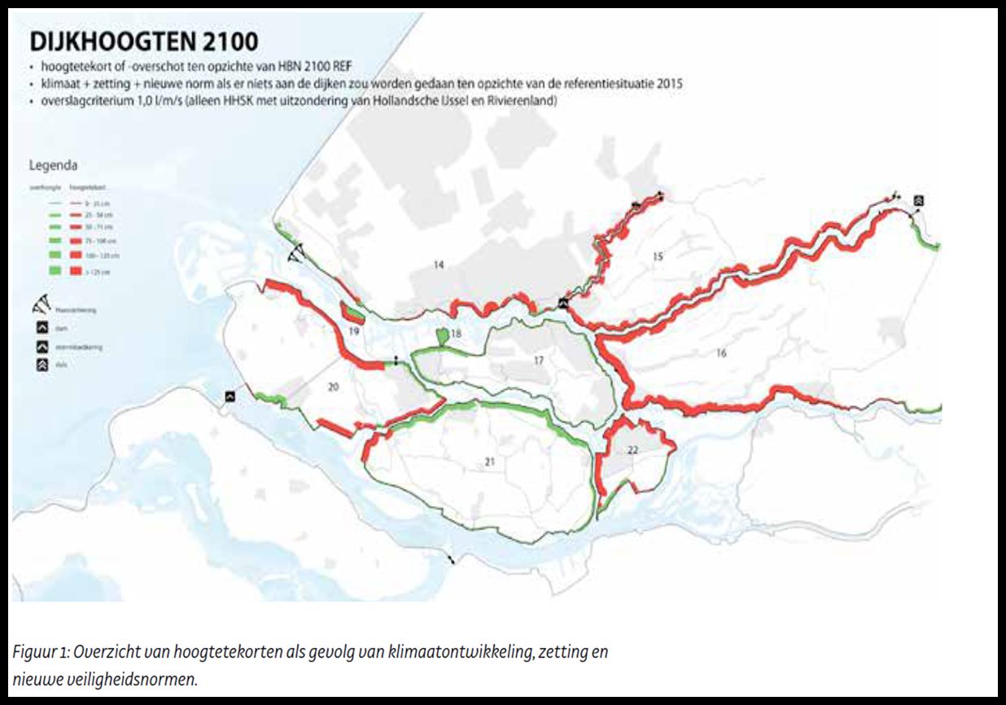
1. System analysis Hollandsche IJssel
Wind causing wave setup
Land subsidence 1,1 cm/yr
Precipitation causing high discharges
High river discharge
Sealevel rise / tidal effect
Notes:
6
1e stuw in de Lek bij Hagestein wind: opzet en golven

Slide 7
System analysis
1. System Analysis with SPR Framework

Slide 8
2. Analyse sets of measures
Dike reinforcement
Use of floodplains
Improvement of HIJ storm surge barrier
Decrease waterlevel HIJ
..
..
Three types of alternatives are studied in this project in particular

Slide 9
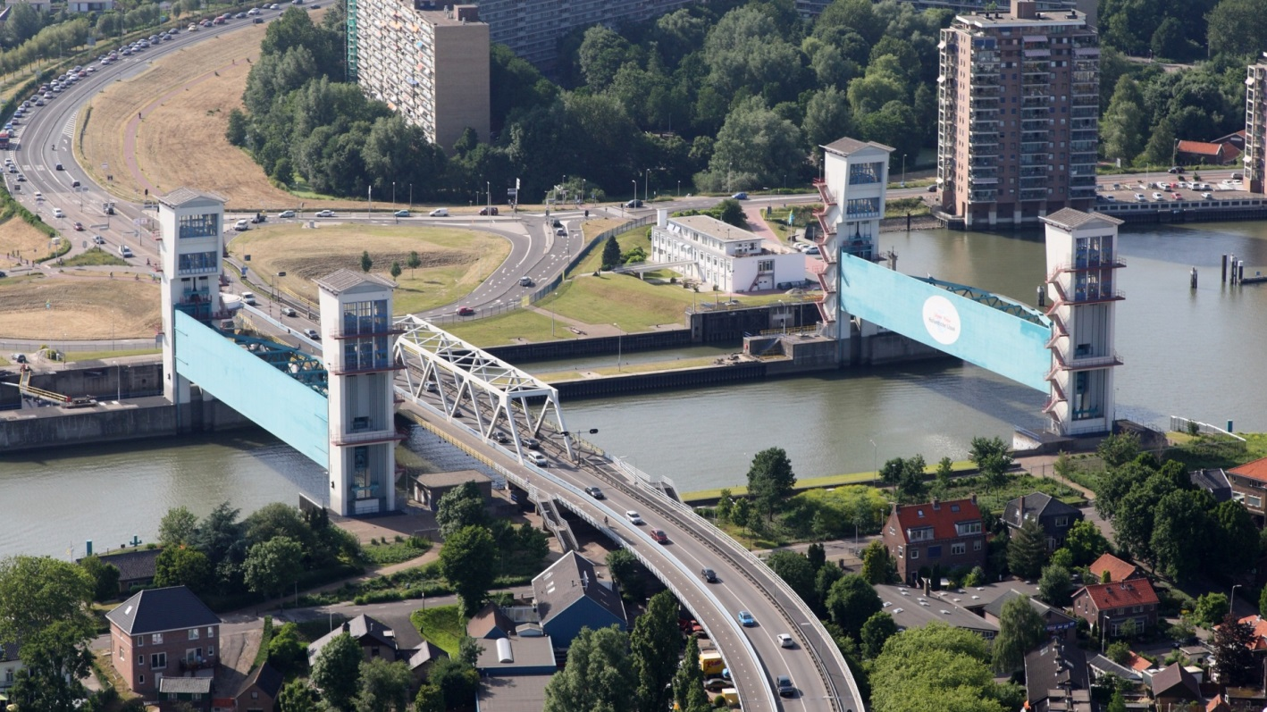
Three new measures are studied, besides dikes and usage of floodplains
Reduction of the failure rate of the SSB Hollandsche IJssel
1: 500, 1: 1000 and 1: 5000 per closure through all types of measures (back up of energy supply, emergency operation better designed, etc.).
  Final draft on possible options discussed in February 2019

Slide 10
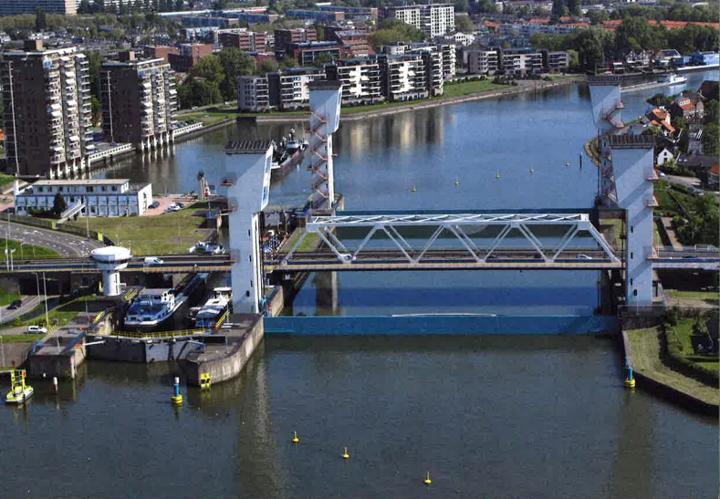
Three new measures are studied beside dikes
Closing the barrier at low tide at the point of reversing current instead of just before high water
Measure is very effective, little negative impact on shipping and road traffic

Slide 11
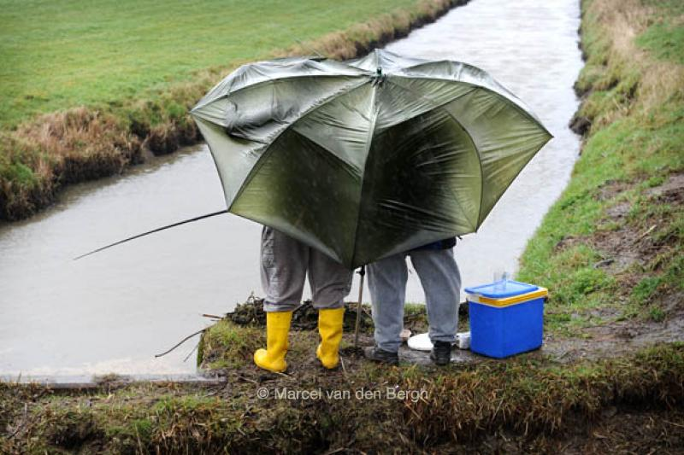
Three new measures are studied besides dikes
3. Limit the volume of water that enters the Hollandsche IJssel from the regional system as much as possible during critical conditions

Slide 12
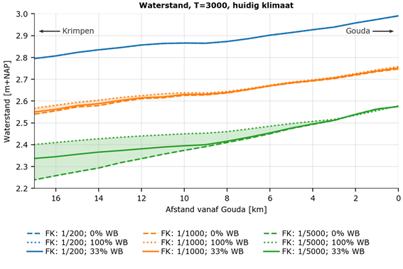
Impact of these measures on the waterlevel
Reproduction of results with a hydraulic model

Slide 13
3. Study costs and external effects
First cost indications, effects will be further qualified/quantified
Investment costs improving SSB HIJK until 1:5000 | 10 million Euro
Savings in investments for dike reinforcements due to improvements SSB HIJ | 50 million Euro
Reduction of damage through flooding | More than a billion Euro

Slide 14
4. Formulate adaptation path
Take existing floodplains into account to calculate the strength of the dikes is very cost effective
In cases of abundant rain, filling up the regional watersystem, it is very useful to close the barrier at low tide at the point of reversing current instead of just before high water.
Investments in a better Storm Surge Barrier HIJ seems to be cost effective, independent of the size of improvements!
The study about the regional water system is complex and still needs a lot of attention

Slide 15
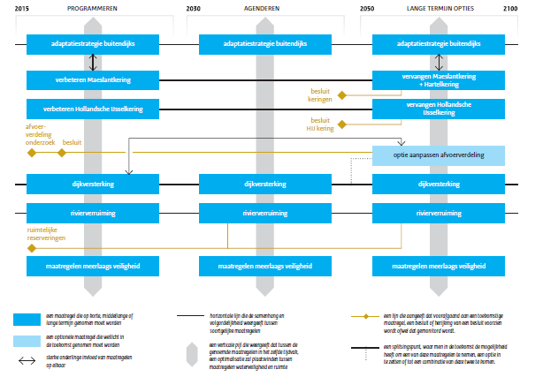
4. Formulate adaptation path(s) (pathway)

Slide 16
To conclude
For flood protection Hollandsche IJssel, it is very effective to work together using a system analyses (SPR framework), study a broad range of solutions and find – together - the most cost effective solutions for flood resilience

