Slide 1
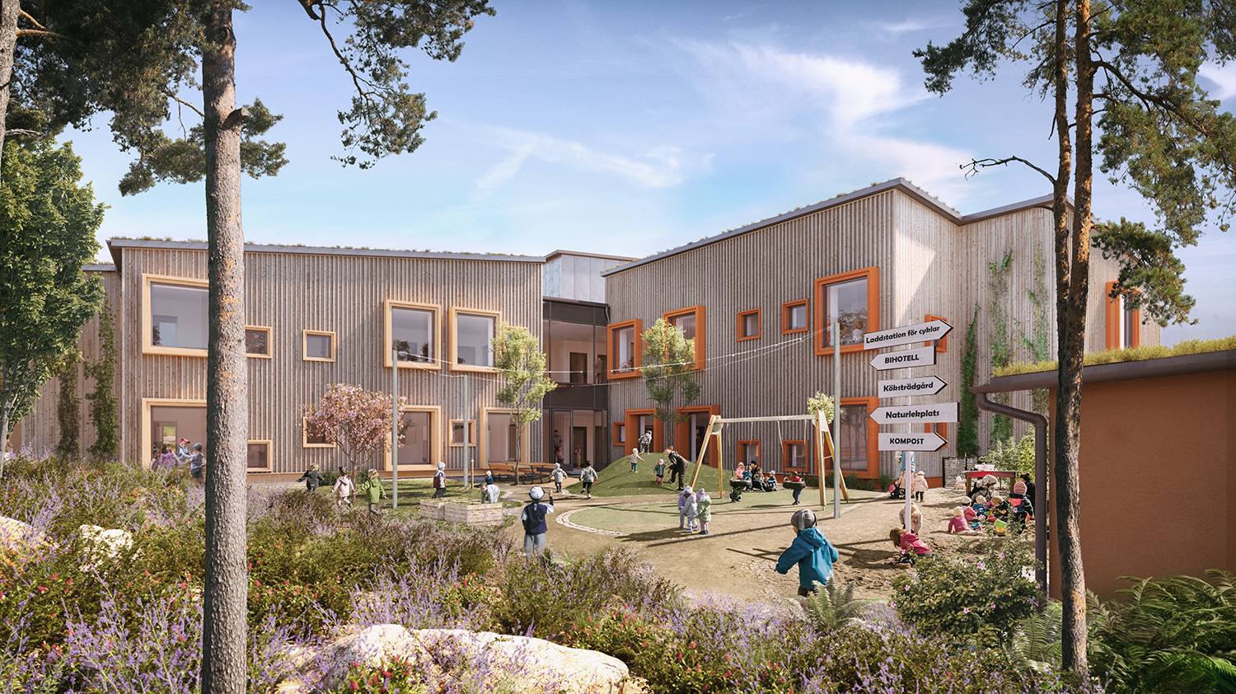
Visualisering - Hoppet

Slide 2
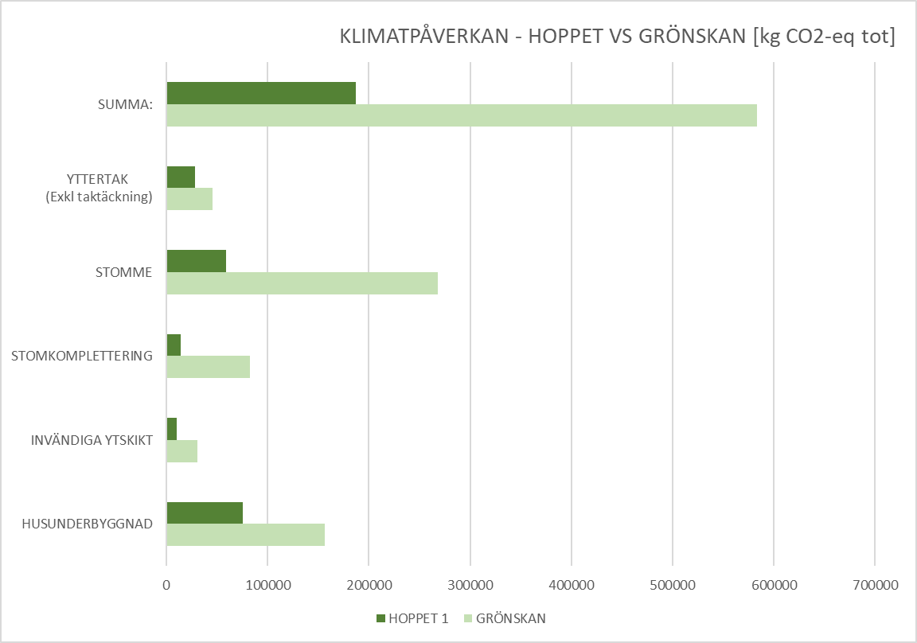
Reduced climate impact framework and foundation 70%

