Slide 4
Progress InVesta
InVesta
Well-filled project portfolio, 1st projects coming online
InVesta Involved in several R&D-programs (TNO)
Start building activities A.S.A.P.
EFRO subsidy: funding for start of 4 project
In general National Policy
More focus on renewable molecules for sectors that can not cope with electricity only
Climate Agreement is facing public acceptance issues
Huge discussion on use of biomass

Slide 5
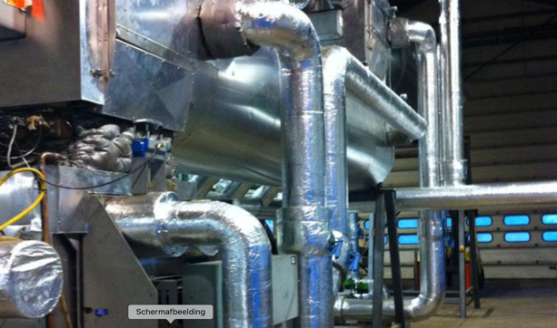
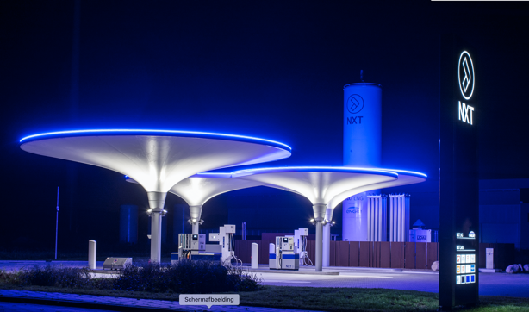
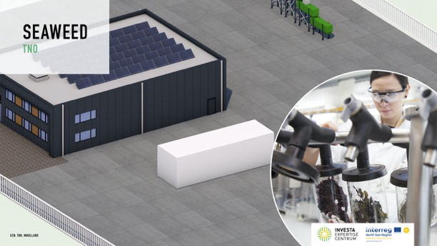
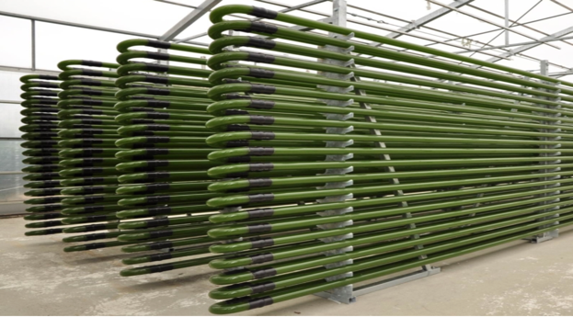
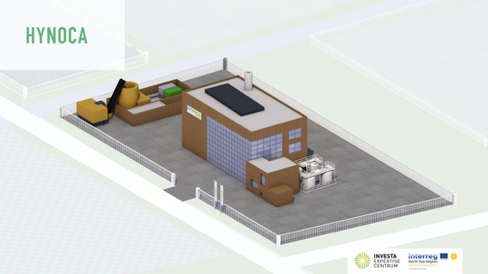
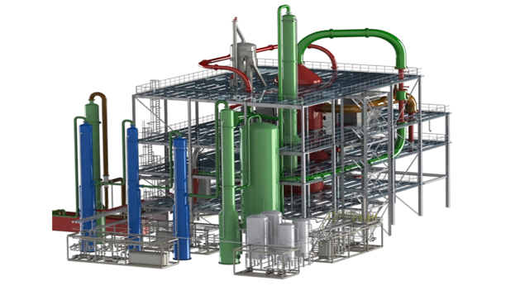
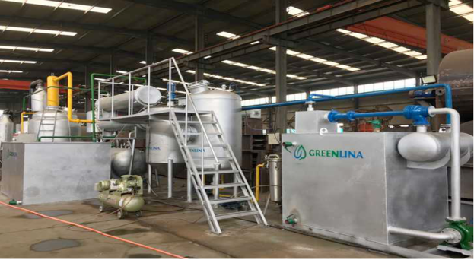
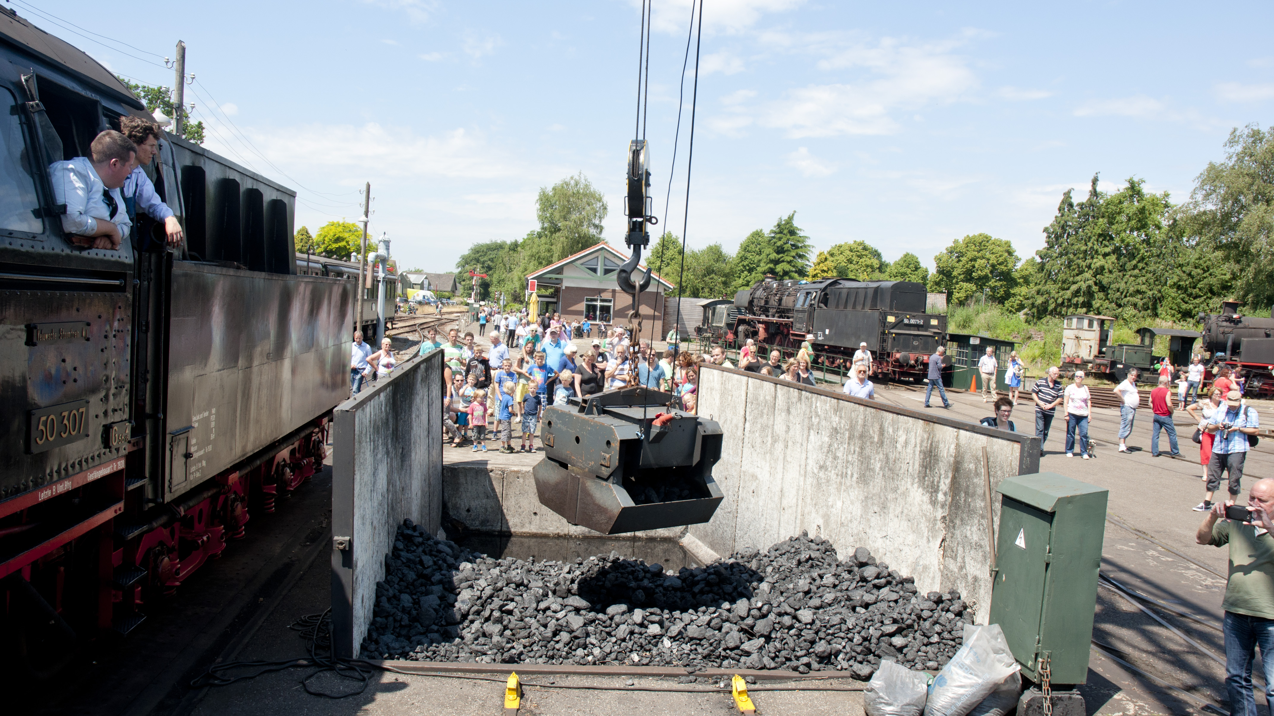
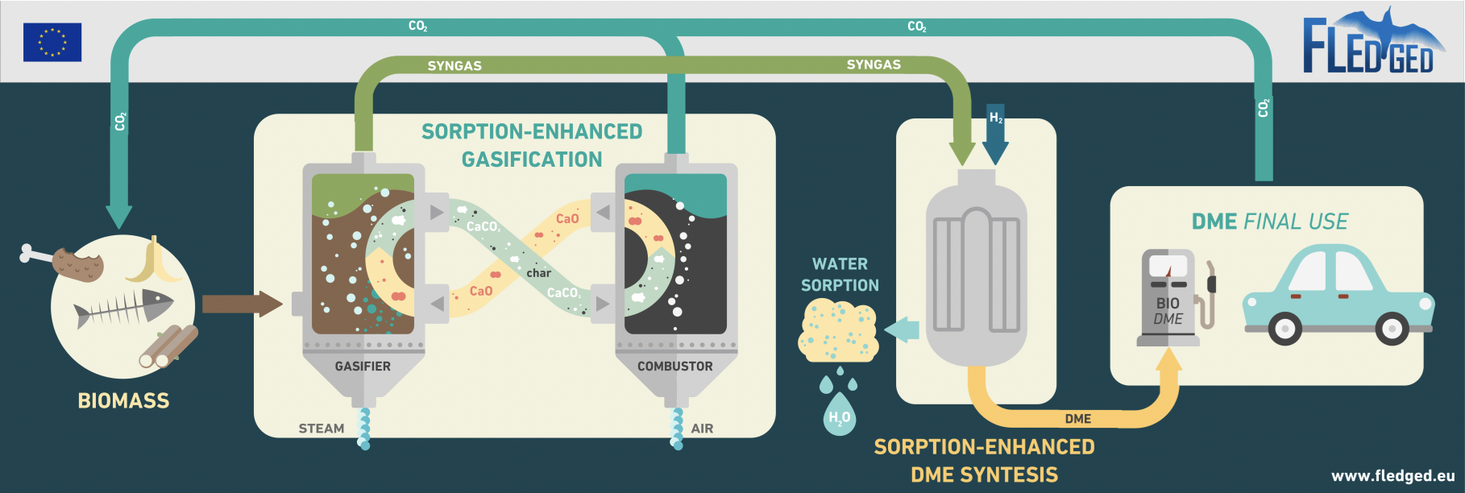
PROJECTS

Slide 6
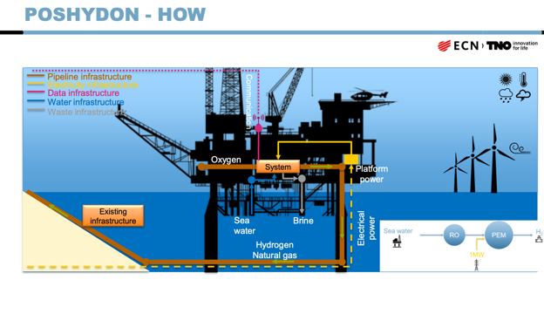
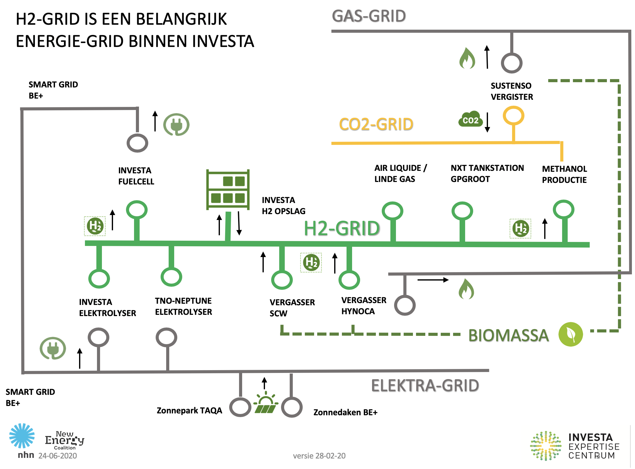
R&D-Programs

Slide 7
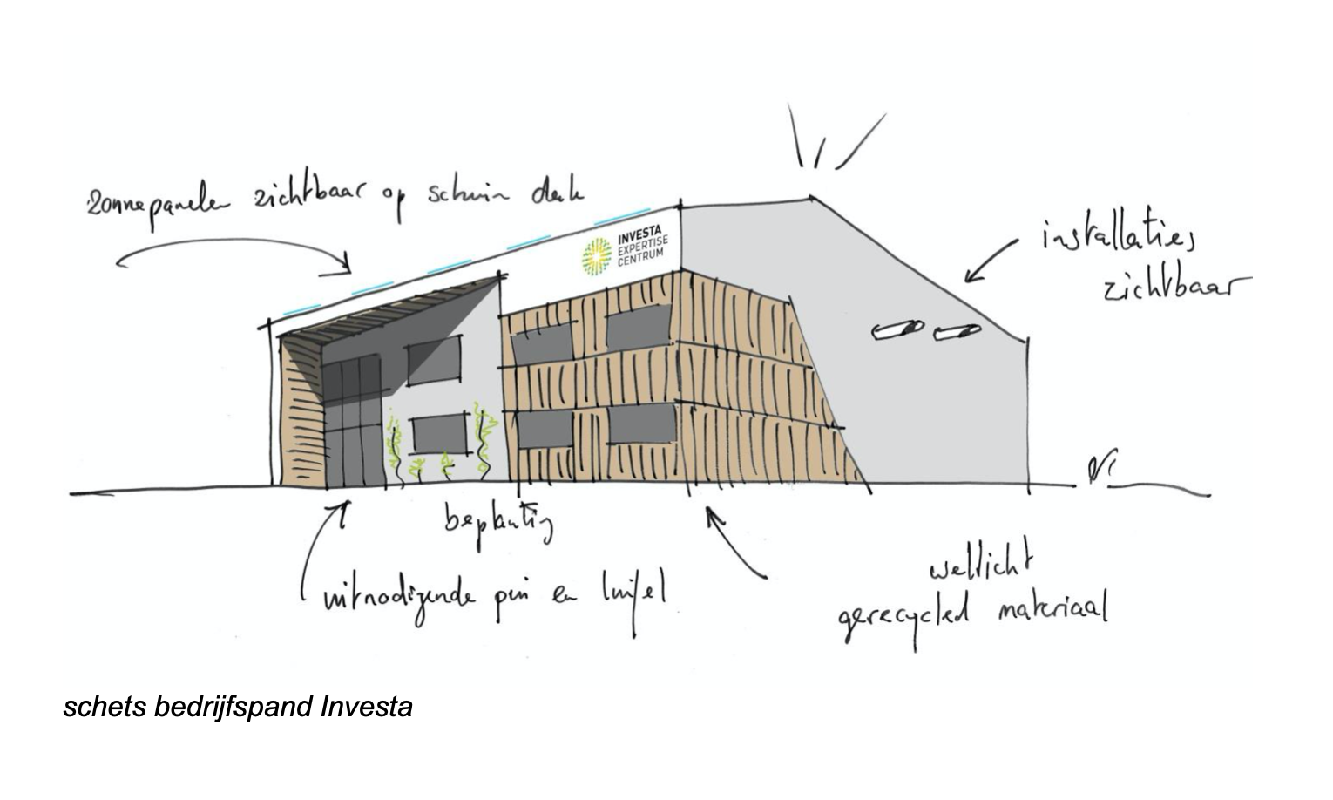
Start building activities InVesta
InVesta and projects work in parallel
New Building InVesta
First utilities contracted
Green gas
Heat network
Electricity for projects
Special facilities for projects

Slide 8
Next
Expanding facilities
Hydrogen HUB Alkmaar
CCU network
Internal heat network
Increasing number of demo projects
Expanding InVesta international network via project such as Northern Connections
Let work together also after the project is finished!

