Slide 1
H2 Aberdeen:
The Journey
Louise Napier
HyTrEc2 Project Manager

Slide 2
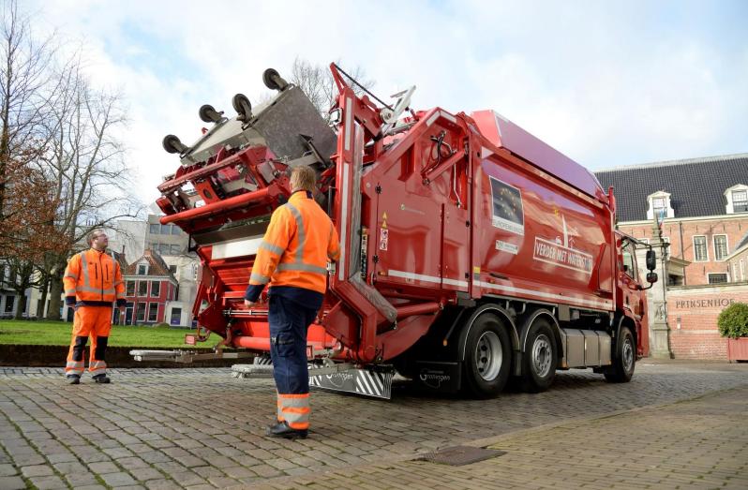
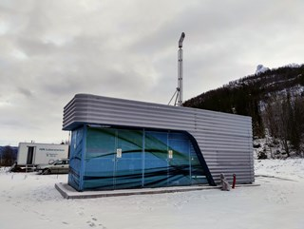
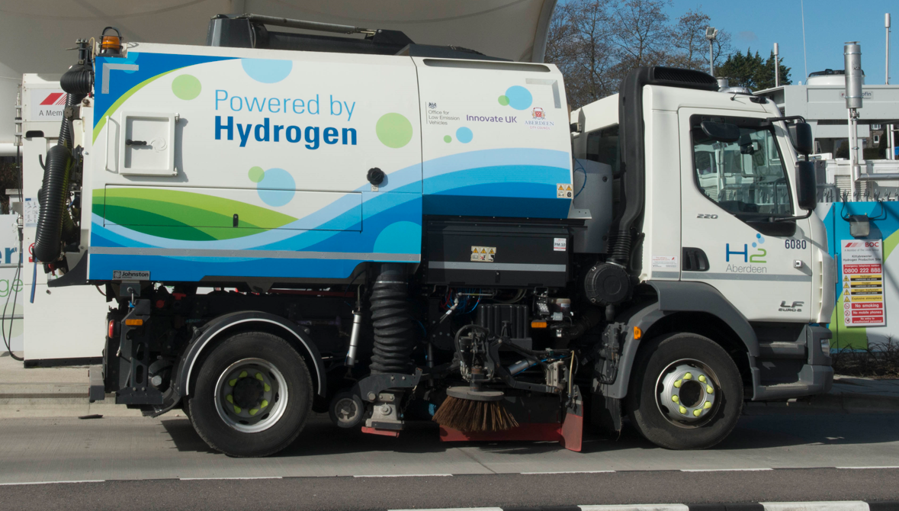
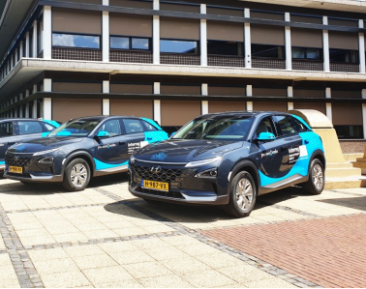
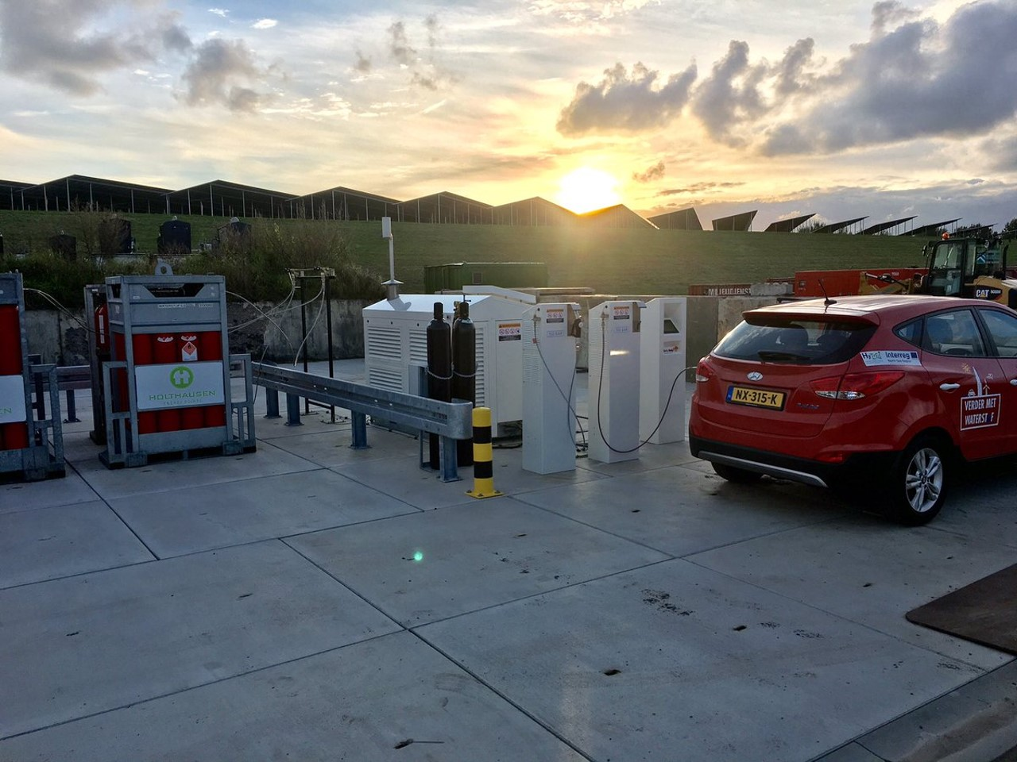
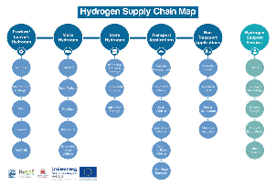
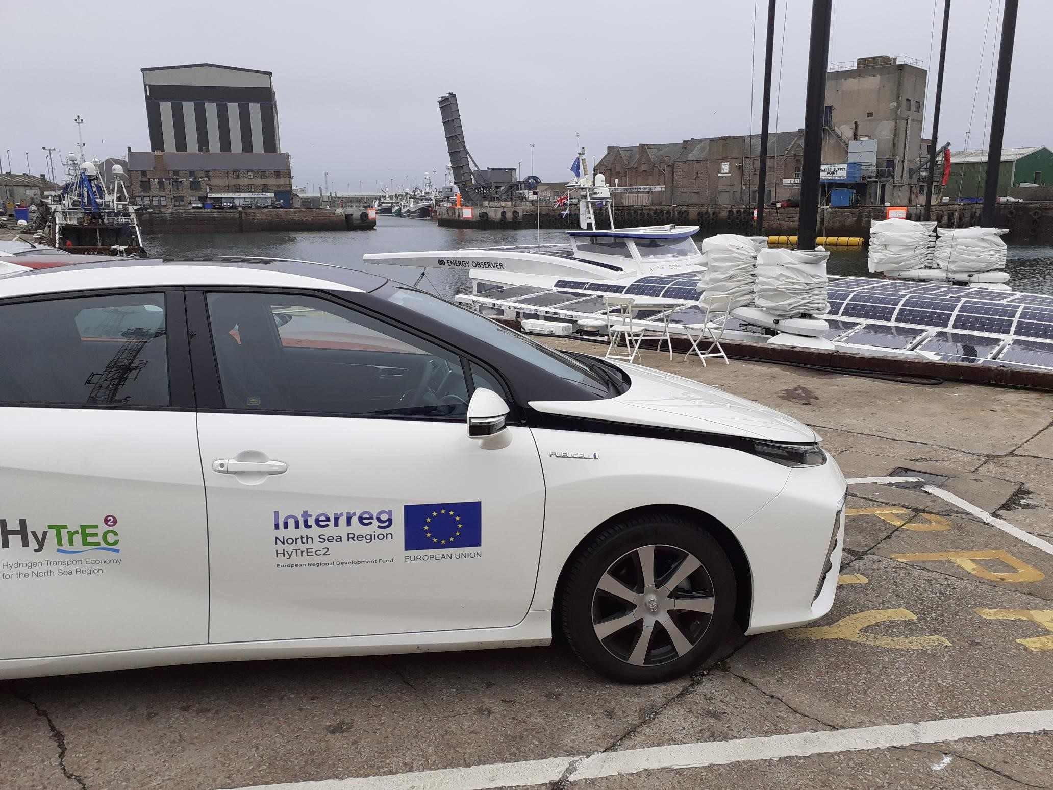

WHY HYTREC2?
HyTrEc2 Partners aim to create the conditions so that a hydrogen market can develop focussed around:
  Vehicle deployments
  Development of hydrogen production and refuelling infrastructure
  Supply Chain, Skills and Training
>90% of transport across Europe is oil based
Current market failure caused by the high cost of both FCEVs and green hydrogen

Slide 3

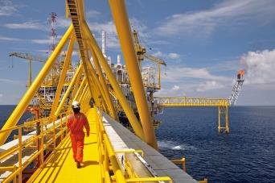
WHY HYDROGEN IN ABERDEEN?
“Scotland for example is still significantly dependent on the oil and gas industry, with over 10% of workers in Aberdeen directly employed by the sector… at least 68% of the UK’s oil and gas workers have skills that could transition to the low carbon sector.”
North Sea Transition Deal, March 2021
Notes:
We’ve all know that climate change is having a real impact across the globe and that when produced using renewable energy, hydrogen provides an opportunity to decarbonise industry, heat and transport as it can also be used as a storage mechanism, can be applied in fuel cells and can also be used as an energy vector. As well as pursuing hydrogen to combat climate change Aberdeen is also pursuing hydrogen for economic reasons as well.
WHY HYDROGEN IN ABERDEEN
“Scotland for example is still significantly dependent on the oil and gas industry, with over 10% of workers in Aberdeen directly employed by the sector. Poorly managed, the transition may have serious impacts on the broader local economy but workers in this sector have a crucial part to play in the transition, at least 68% of the UK’s oil and gas workers have skills that could transition to the low carbon sector.” North Sea Transition Deal March 2021
Workforce are highly skilled and specialised
region’s expertise in subsea engineering, renewables, energy technology and production transitioned to development of Hydrogen production, storage and distribution infrastructure
51.7% of working age population have NVQ4+ qualifications – significantly higher than both the Scottish and UK average
Forty years of excellence in the Oil & Gas sector
Want to retain this skilled labour

Slide 4

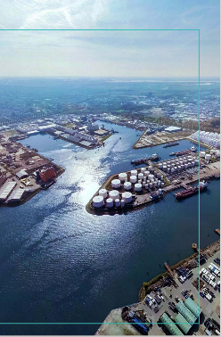



WHY HYDROGEN IN ABERDEEN?
Offshore Wind - North East Coast
Aberdeen at the forefront of UK Energy Transition
Energy Transition Zone and Aberdeen Harbour
Highly Skilled North Sea Workforce

Slide 5
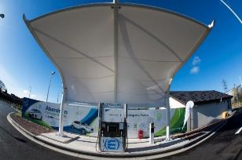

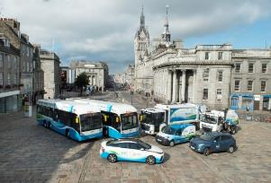
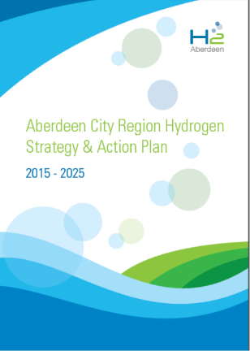
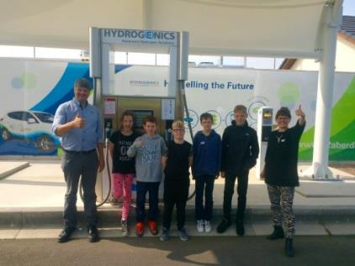
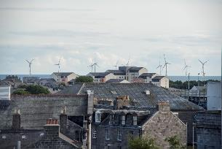

Slide 6
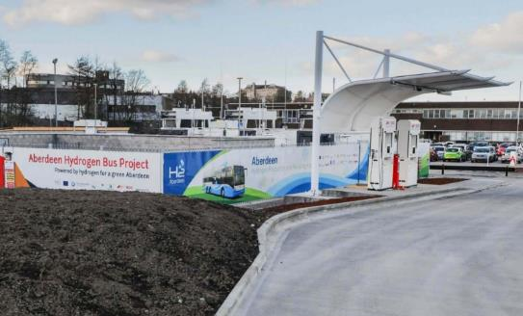
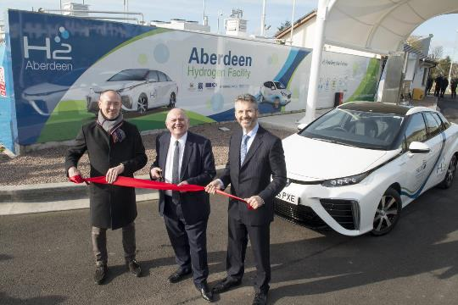
REFUELLING INFRASTRUCTURE
2 stations delivering 130 and 360kg/ day
350 & 700 bar capable
Refuel cars, vans, buses, large vehicles
Both ‘green tariff’ stations
Kittybrewster
ACHES, Cove
Notes:
Aberdeen has 2 publicly available hydrogen refuelling stations. 3 in Scotland.
Kittybrewster station (2015) = largest and most reliable dedicated bus refuelling station in the UK and is capable of dispensing up to 360kg of hydrogen per day. Capacity to store 420kg on site. In 2018 the station was upgraded to allow the refuelling of cars and vans at 700bar in addition to the buses.
Built, operated + maintained by BOC.
ACHES – Aberdeen City Hydrogen Energy Storage - dedicated car and van refuelling station which opened in 2017. It is also a dual pressure station and is used to increase awareness and provide familiarisation and training, as well as provide real live operation and maintenance experience to local companies. Built by Hydrogenics. Dispenses 130kg per day. Additional 150kg capacity. Operated by NORCO.
Both stations run off green tariff electricity from the National Grid which is electricity from renewable sources. Hydrogen is produced via electrolysis: Electricity is used to split the hydrogen from the oxygen in water molecules.
This means all of our hydrogen vehicles in the region are zero emissions from well to wheel.

Slide 7
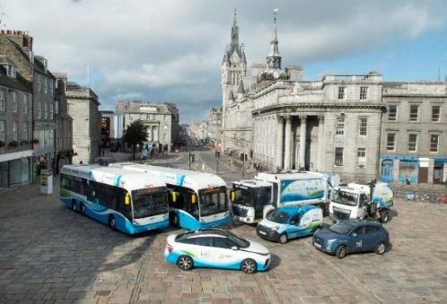
HYDROGEN MOBILITY IN ABERDEEN
Aberdeen has one of the largest and most varied fleets of hydrogen vehicles in Europe.
Notes:
WHY HYDROGEN IN ABERDEEN
focus has primarily been on h2 for transport
ACC has been recognised for it’s achievement: range of awards and world firsts; one of the largest and most varied fleets of hydrogen vehicles being trialled in Europe. OVER 70 vehicles so far,
We have one of the largest and most varied fleets in Europe next few slides show this

Slide 8

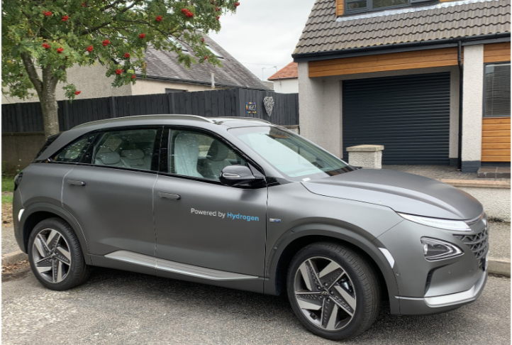
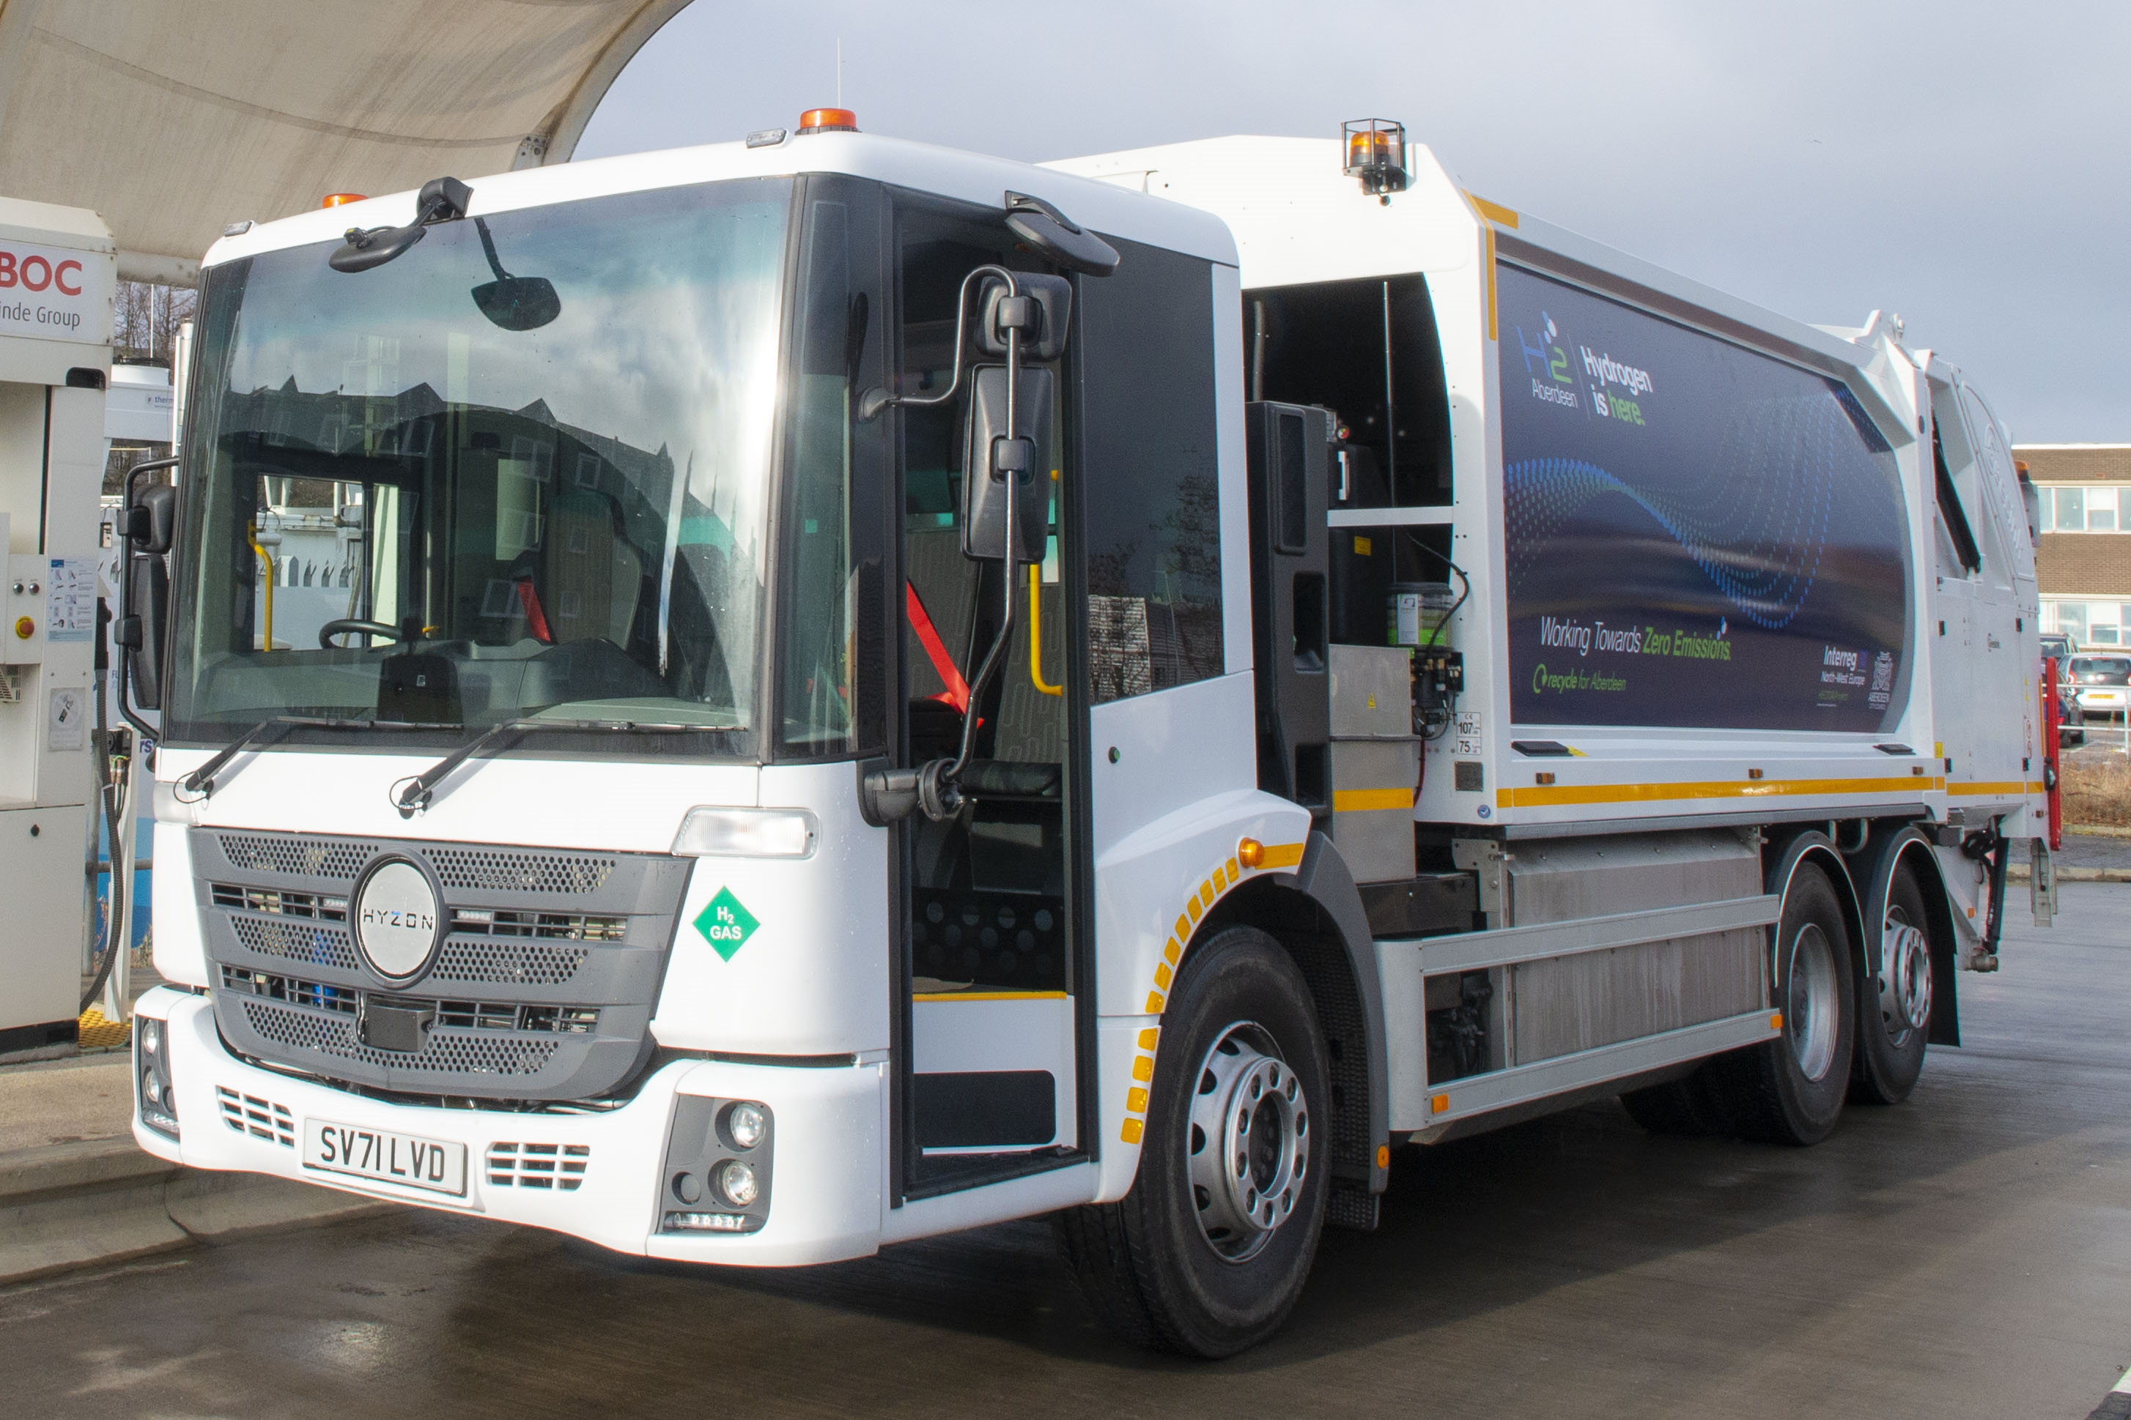

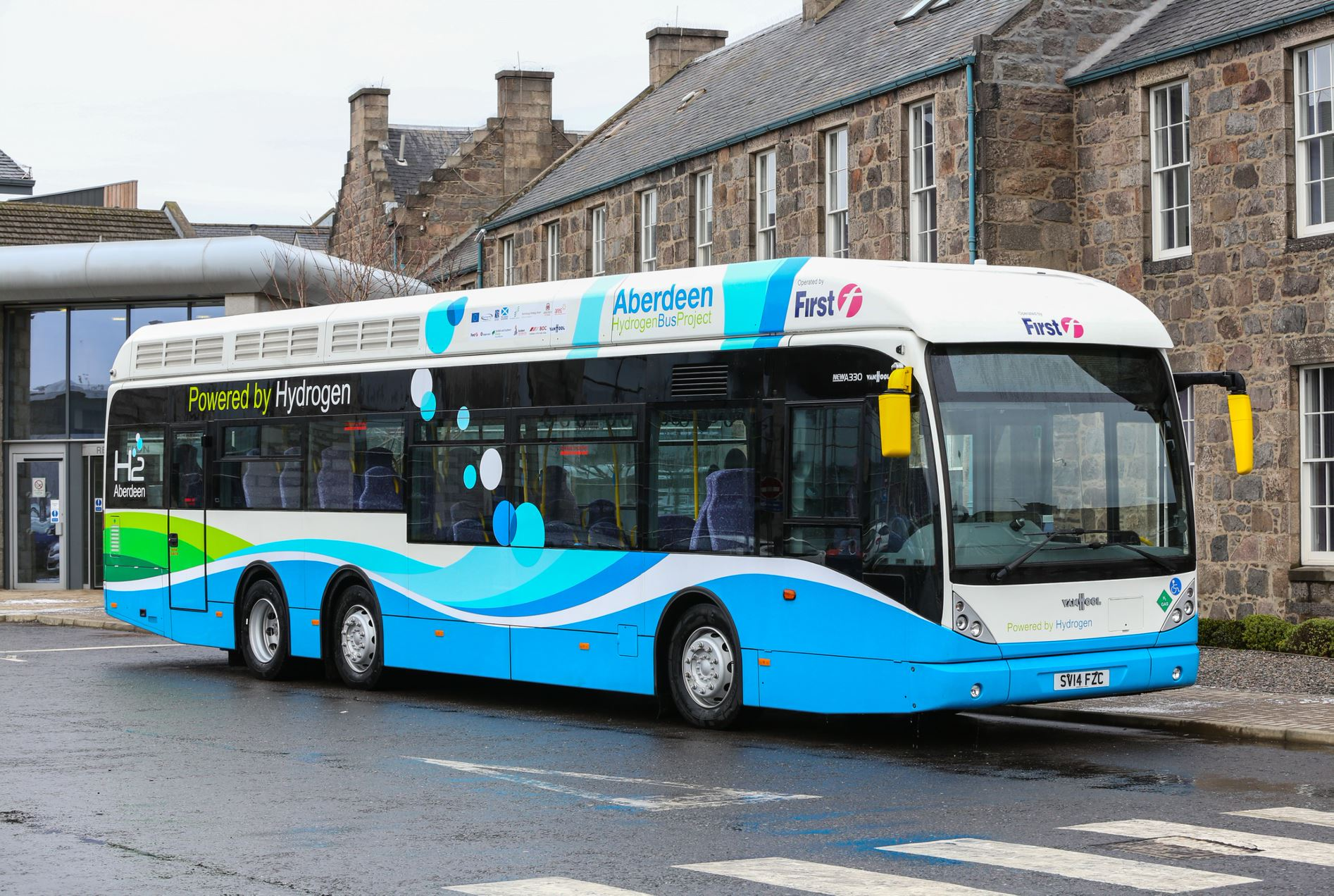

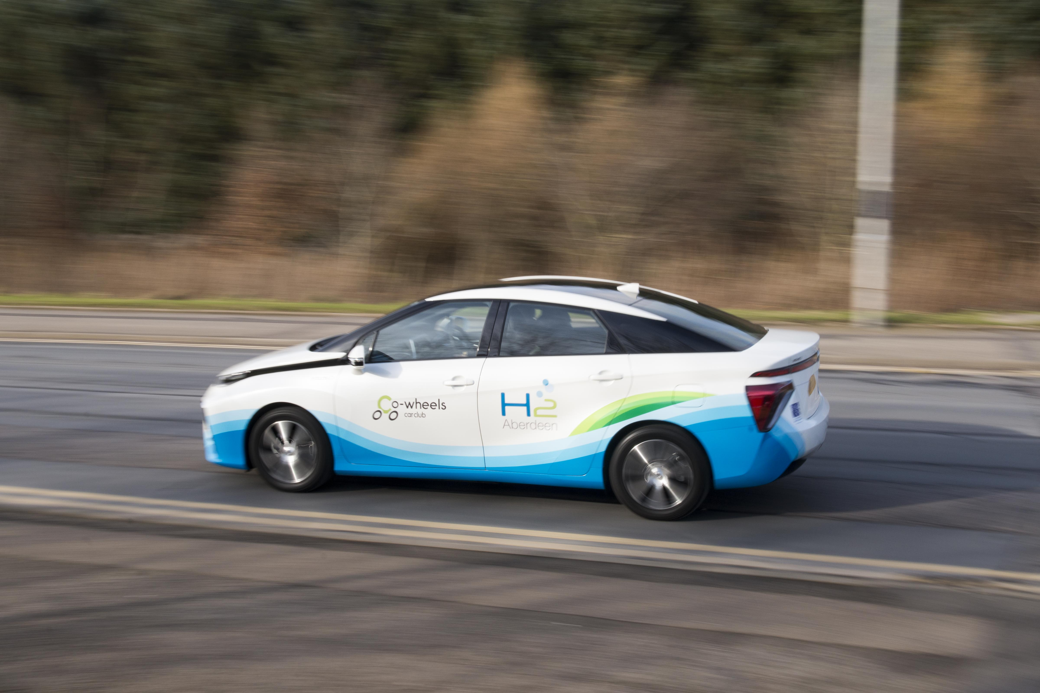
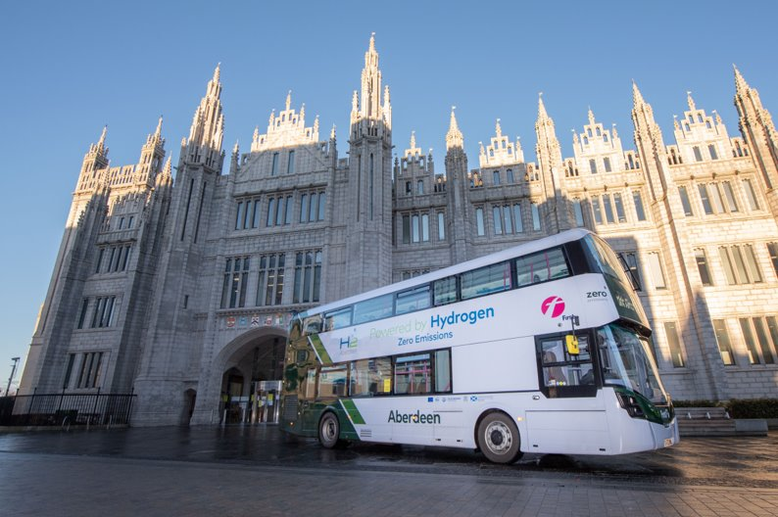
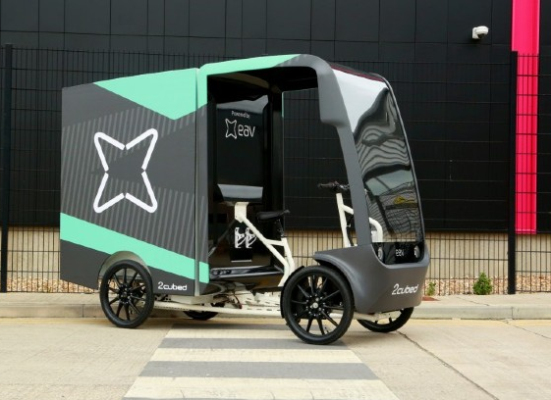


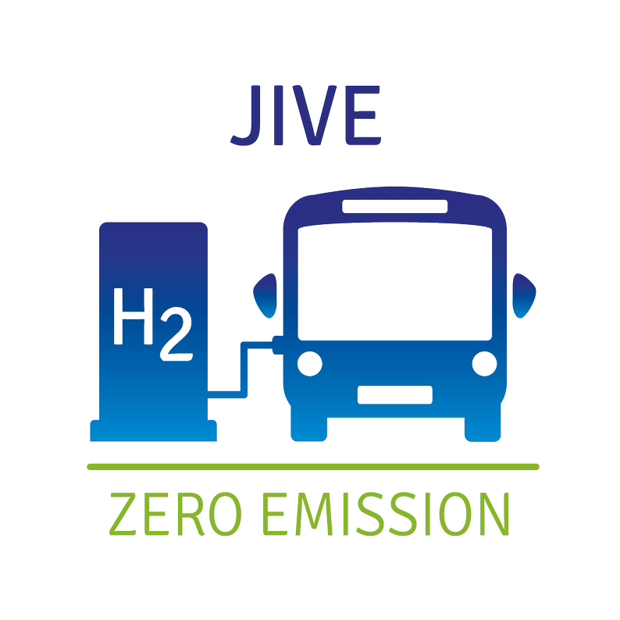


FUEL CELL ELECTRIC VEHICLES
Fuel Cell Vehicles (FCEV)
Estimated to save 1 kg of CO2 per km driven
Notes:
Working in partnership with a number of programmes and projects in the UK and Europe including FCH JU, Interreg North Sea Region, Interreg North West Europe and Interreg Europe to deliver a hydrogen fleet.
ACC is actively engaged in encouraging other organisations to adopt hydrogen vehicles across our region in order to reduce carbon emissions.
Ix35 = first FCEV ACC purchased. 5.64kg = 369 miles; 3 mins; LEFT HAND drive!
Mirai = 5kg = 300 miles; 3 mins @700bar;
Nexo = 6.3kg = 414 miles; 5 mins = used by Lord Provost for Civic duties + also co-wheels
ALL on Co-wheels Car Club for members of the public to trial .
Necessary for ACC to actively engage in vehicle deployment, but as the hydrogen sector develops further it is anticipated that the private demand will increase

Slide 9
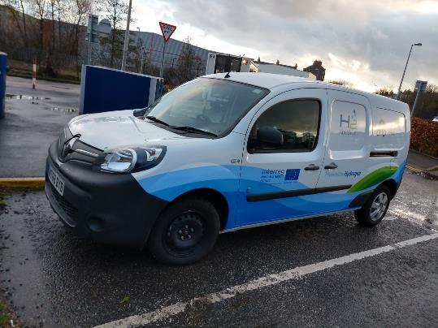
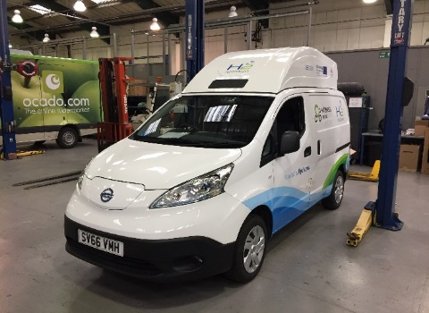
FUEL CELL RANGE EXTENDED ELECTRIC VEHICLES
EVs can incorporate hydrogen to extend their range.
Zero tail pipe carbon emissions.
Notes:
Battery electric vehicles (BEVs) can also incorporate hydrogen to extend their range. A battery vehicle can be retrofitted with a hydrogen tank to boost their drive time. This is a nifty solution that extends drive time thus alleviating range-anxiety. Hydrogen range extended vehicles can be particularly useful for individuals living in remote locations or those who rely on their vehicle to drive for lengthy, uninterrupted periods. This combined solution is also a viable option for those larger vehicles that carry significant load, which may not perform optimally on BEV alone.
ENV200 Nissan
74litre tank @ 350bar pressure placed at the top. Refuelling: once a day
Electric charging: Rapid charge 40-60 mins
Electric vehicle mileage: 106 miles (real life 90 miles) + 45miles extension with h2. - adds additional 40-50% drivetime onto the EV baseline figures
£55k retrofit & materials; Lifecycle: Tanks have 15 year life cycle
Equipment location: on top of the van leaving inside free for Integration
Renault Kangoo is a 22kWh battery electric van with hydrogen range extender.
It has a 2kg hydrogen tank which takes 8 minutes to refuel at 700bar, this delivers a range approximately of 220mile

Slide 10
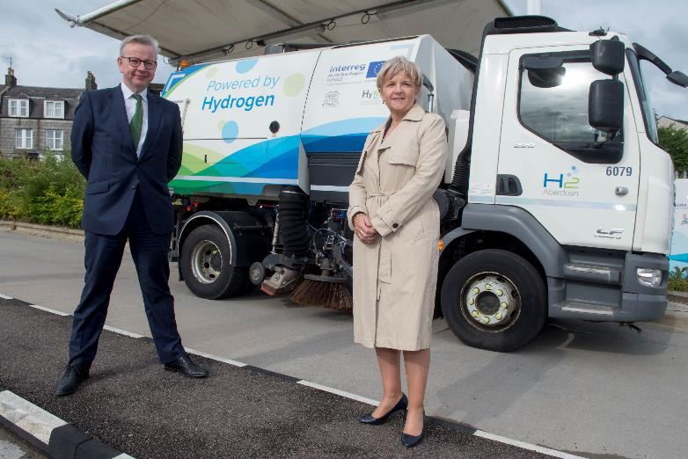
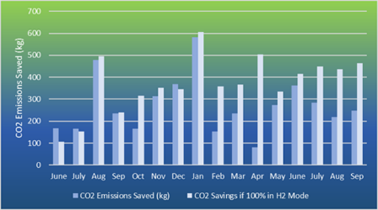
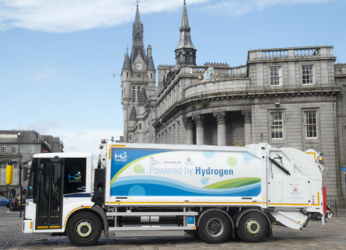
H2 ICED VEHICLES
Notes:
Dual-fuel combustion is an interim technology for those first exploring hydrogen transport options.. Dual-fuel combustion allows organisations to continue using their current vehicles whilst reducing their emissions. It is a helpful bridging technology which makes hydrogen more accessible straight-away.
Graph showing CO2 savings. Technology saves 30-40% of CO2 emissions.
2 retrofitted diesel-h2 DAF roadsweepers + 1 on order
74litre tank (1.5kg h2) to 205 litre tanks (4.8kg h2) or 2 x 74 litre tanks @ 350bar. 30% CO2 reduction.
2 tanks = power both engines (including auxiliary engine)
£40,000 - retrofit and materials; H2 range: 51km dual-fuel range (per tank); Average distance: 50km per working day
Mercedes waste truck
H2 range (km) – 180km – 110miles dual-fuel range (per tank)
Frequency of refuelling – Every day (could last up to three days based on % of H2 left in tank)
Av distance – 55km per working day
See in Jan 2020 able to save 600kg of co2 emissions

Slide 11
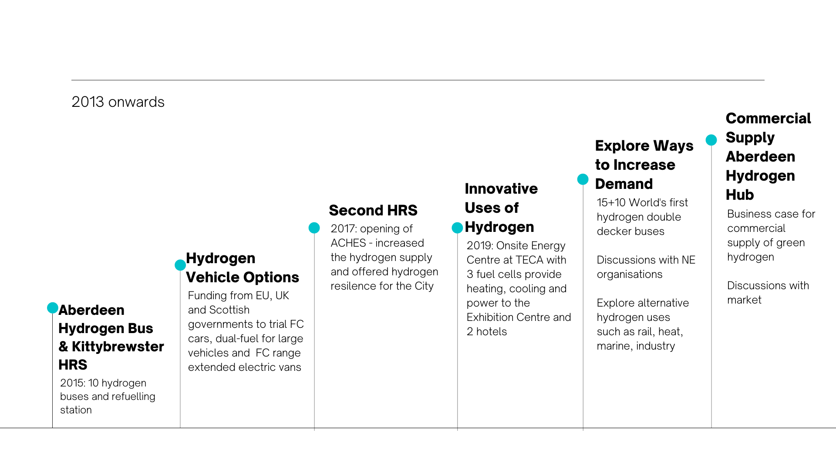
H2 ABERDEEN TIMELINE
Notes:
Since we started in 2015 with the 10 buses and the Kittybrewster refuelling station we have learnt a lot. We have continued to explore other hydrogen road transport options, including more FCEV, dual fuel and range extended EVs. We opened second refuelling station in 2017 in the south of the city to provide hydrogen resilience and increase the supply of h2. We have delivered innovative uses of h2 – such as the TECA site which opened in 2019 that is powered and heated by a series of three fcs.
WE have increased demand further by getting the additional 15 buses, soon to be followed by a further10. & constructed a business case for the commercial supply of green hydrogen in the region.
Currently exploring ways to increase demand, in order to reduce cost of h2 at pump & developing a commercial supply to achieve cost parity with diesel. the rest of the presentation will explain more details of the hub.

Slide 12
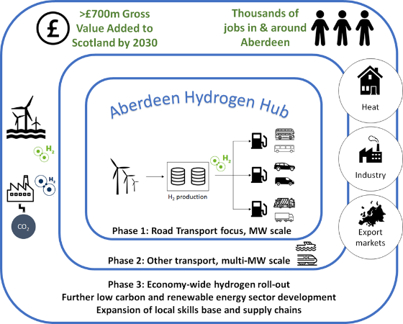
ABERDEEN HYDROGEN HUB
Phase 1 – provision of a resilient, cost-effective supply of green hydrogen on a commercial basis to the market to support the existing and proposed transport projects.
Phase 2 – Expansion in the short to medium term to connect to larger volume utilisation of hydrogen – trains, trucks and marine.
Phase 3 – Whole system approach to supply and demand. Innovation, skills and transition hub to support expansion of the local supply chain. Pursue the ambition for Aberdeen to be the centre of a brand new Energy production business, exporting H2 to the world.
Notes:
The Hub’s aim is to provide cost-effective commercially produced green hydrogen supplied from renewables to support the City’s existing and proposed transport projects as well as heat, industry and export in later phases
The potential economic benefits of being at the forefront of this transition are significant: £700m gross value add to Scotland’s economy by 2030, as well as retaining thousands of high-value jobs in Aberdeen and the surrounding region

Slide 13
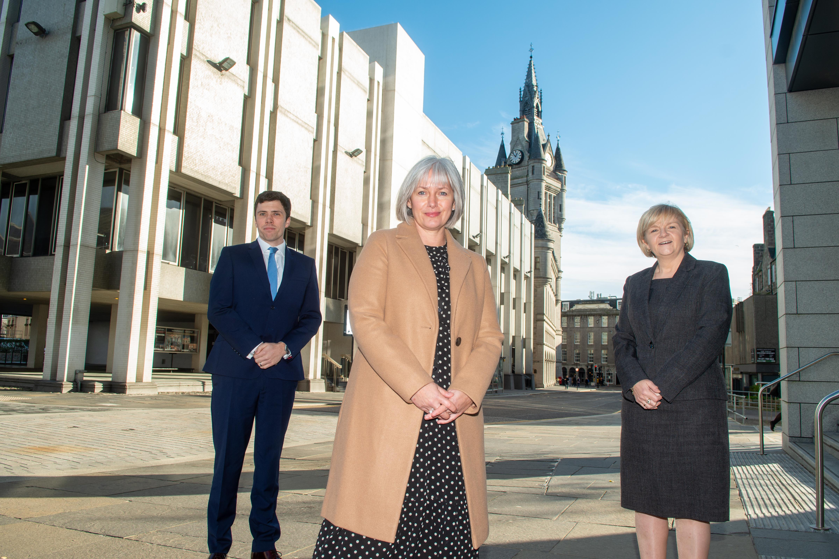



ABERDEEN HYDROGEN HUB
On 3rd February 2022 announced a new Joint Venture company wholly owned and funded by both the Council and bp to deliver the Aberdeen Hydrogen Hub
bp will build, operate and manage the Hub including:
  Solar power array
  Green Hydrogen production facility
  Refuelling for public transport, trucks, cars and vans
The Hub will be Scotland’s first scalable green hydrogen production facility with first gas expected in 2024
Inclusive growth by supporting hydrogen supply chain developments, skills and training and wider community benefits
Potential for delivery of future phases could see production scaled up for export through larger volumes of hydrogen using offshore wind developments
Notes:
Aberdeen City Council has very much put hydrogen at the heart of our energy transition plans and as Council we are planning to directly invest in innovative technologies and demonstrate how they can both reduce emissions and create jobs in the local economy.
In 2021 our budget pledged £19 million for a new Hydrogen Hub that will generate additional private sector investment.
On 3rd February we announced a new Joint Venture company wholly owned by the Council and bp to deliver the Aberdeen Hydrogen Hub.
Bp will build, operate and manage the Hub including delivery of a solar power array, green hydrogen and refuelling facility for the City’s public transport fleet, trucks, cars and vans.
First gas is expected in Quarter 1 of 2024 and there will be significant opportunities for the hydrogen supply chain and for reskilling and retraining to renewable energy.
Future phases could see production of green hydrogen scaled up for export and links to offshore wind developments.

Slide 14
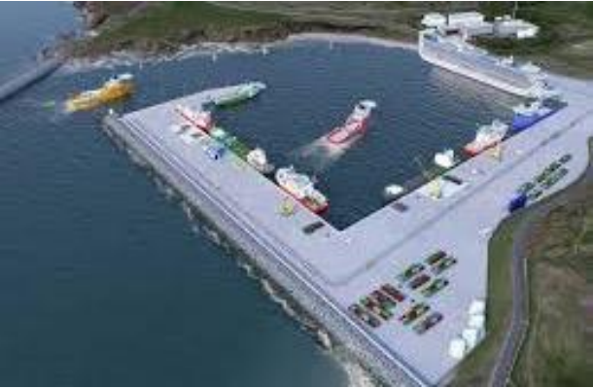
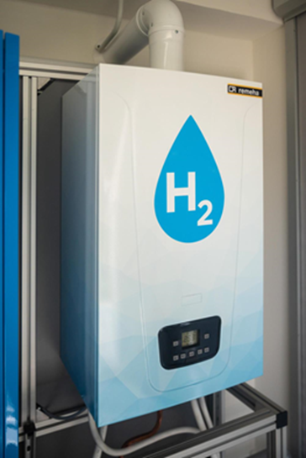
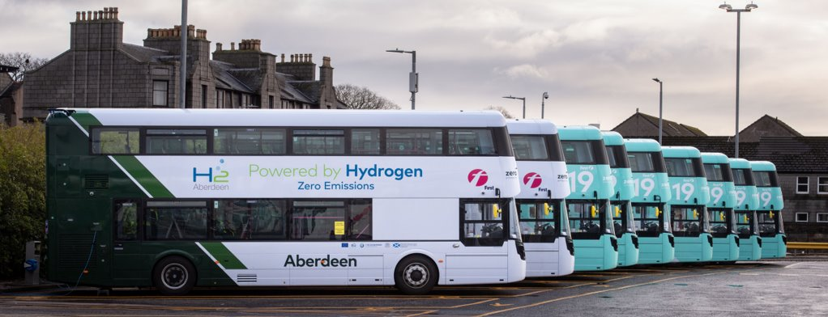
THE FUTURE…
Raising demand for hydrogen across City Region – working collaboratively with neighbouring authorities on fleet procurements
Includes further deployment of buses and retrofitting Council fleet – Council has committed to large scale retrofit of H2ICEd and adoption of h2 vehicles
Adaptation of City Council facilities for interim hydrogen and tube trailer refuelling for wider distribution – TECA and ACHES
Bids to Scottish Government Energy Transition Fund, Green Growth Accelerator Fund and Horizon Europe
Kittybrewster Depot Upgrade for hydrogen and electric vehicles
Hydrogen for heat in District Heat Network, maritime and rail applications
Working with North East Scotland Hydrogen Ambition Group (NESH2A) and collaborating with other H2 projects across the region including CCUS, AD Plant H2, Offshore Wind H2 and more….
Notes:
Aberdeen City Council has very much put hydrogen at the heart of our energy transition plans and as Council we are planning to directly invest in innovative technologies and demonstrate how they can both reduce emissions and create jobs in the local economy.
In 2021 our budget pledged £19 million for a new Hydrogen Hub that will generate additional private sector investment.
On 3rd February we announced a new Joint Venture company wholly owned by the Council and bp to deliver the Aberdeen Hydrogen Hub.
Bp will build, operate and manage the Hub including delivery of a solar power array, green hydrogen and refuelling facility for the City’s public transport fleet, trucks, cars and vans.
First gas is expected in Quarter 1 of 2024 and there will be significant opportunities for the hydrogen supply chain and for reskilling and retraining to renewable energy.
Future phases could see production of green hydrogen scaled up for export and links to offshore wind developments.

Slide 15



Hydrogen is here.
Northsearegion.eu/hytrec2
@H2Aberdeen
H2 Aberdeen
H2 Aberdeen
Notes:
You sit in this room with some of the most forward thinking people and organisations working on hydrogen in Europe.
I wonder if the H2 Aberdeen team can please stand up? These are some of the team members working on the projects mentioned in this presentation – who have delivered the first hydrogen vehicles on a car club for the public to try, the UK’s first Fuel Cell electric truck. You can ask them any question on hydrogen today and they will endeavour to find an answer for you.
Yasa who tirelessly worked across Europe to secure funding for development of hydrogen projects in Aberdeen and alongside Chris, who have worked on some of the first European transport projects.
We have south west College here today that produced some of the first publicly accessible hydrogen material in the UK
Rachael from ESP who is working with Colleges across Scotland to produce hydrogen courses for wider roll out and has developed courses on hydrogen awareness and transport that are available online.
Mohamad from the University of Tromso whose work in Narvik has helped encourage TECO2030 to set up in Northern Norway to make fuel cells
Richard from Wrightbus who have produced the first double decker fuel cell electric bus in the world
Nicola and Ryan from ULEMCo who have produced a number of firsts in the world, but who have worked with Aberdeen on the worlds first dual fuel DAF roadsweeper, Nissan env200 van conversion and well theres more to come!
Bp who have formed the UK’s first public sector joint venture to deliver a hydrogen hub alongside Aberdeen City Council
And I would like you now to add yourselves to the list of firsts as well. This is the first hydrogen transport training event to be offered in the City showing such a range of different hydrogen vehicles with so many world leaders in hydrogen and I hope that I certainly hope that I am sitting in the audience in 10 years time while some of the students here today relate their hydrogen journey as well

